Slide 1

Example of propaganda communication

Slide 2
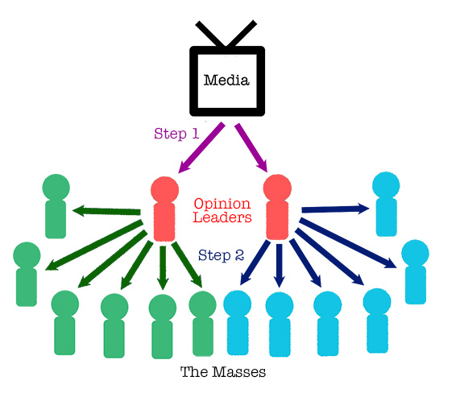
Example of a communication using the two steps flow startegy

Slide 3

Example of communication targeting young men

Slide 4
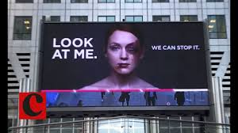
Example of communication targeting young women

Slide 5
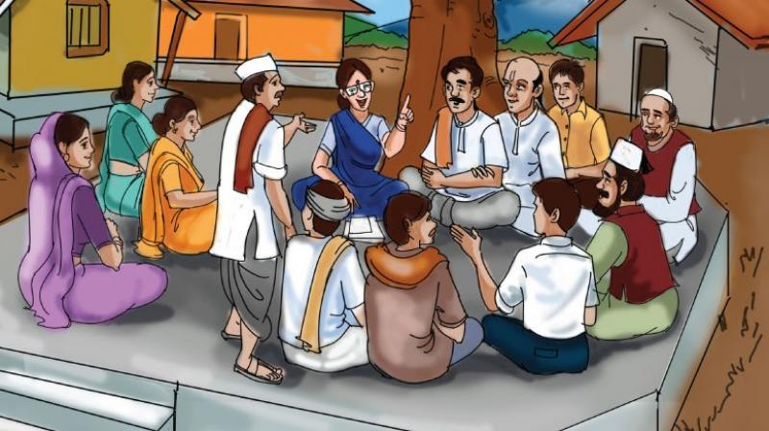
Example of public service communication

